Slide 1
Planets and a little mythology
Jennifer Ma, Lance Ding, Hibiscus Chen

Slide 2
So what makes a planet a planet?

Slide 3
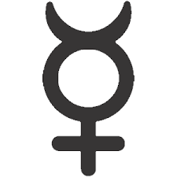
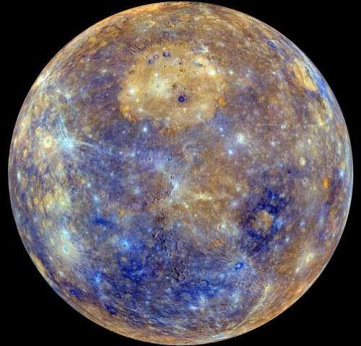
mERCURY
-smallest and innermost
-tidally locked
- have a solid silicate crust and mantle, a deeper liquid core layer, and a solid inner core.
-a terrestrial planet in solar system.
-have a lot of craters
-no moons
-a day is 176 earth days,
-a year is 88 earth days. (https://www.youtube.com/watch?v=OJrl733eyfY)

Slide 4
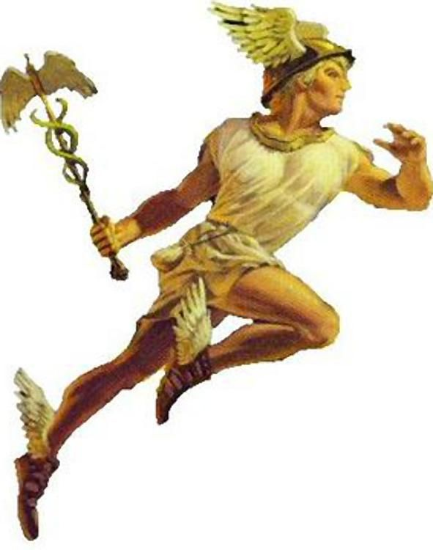
Mercury-hermes
Related to trade, athletes and business
Messenger of all the other Gods
The name is related to Wednesday
Words like Mercantilism, Mercurial
Youngest of the 12 Olympian Gods
Runs fast

Slide 5
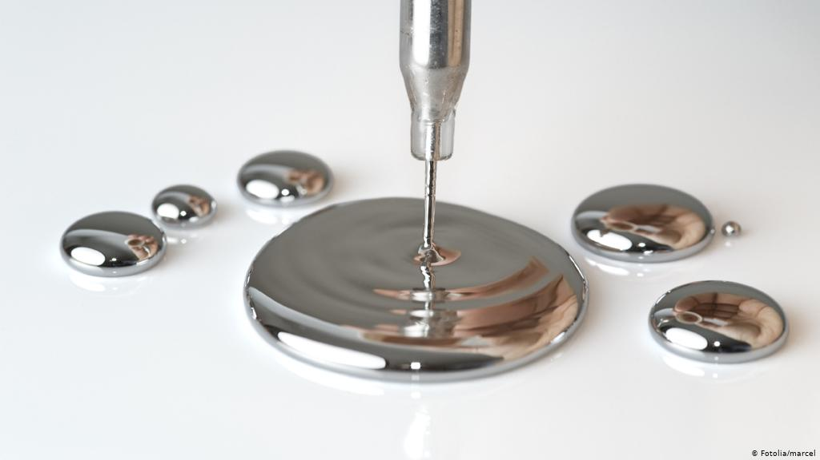
A little association of Chem??
Mercury (Hg)
characteristics of speed and mobility
Liquid metal in room temp

Slide 6

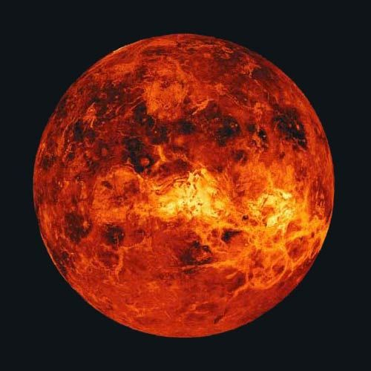
Venus
-Second planet from the sun, the sibling of Earth.
-the second brightest natural object in the sky
-rotate 243 earth days, takes longer to rotate about its axis than any other planets in solar system.
-no moons
-rotate in the opposite direction (sun rise in the west and sets in the east)
-deadly hot (Greenhouse Effect)

Slide 7
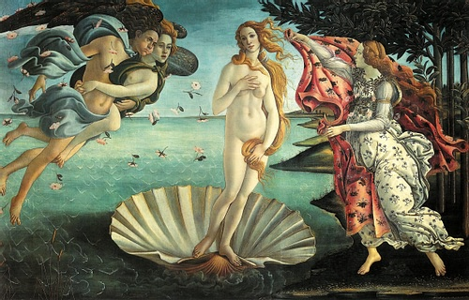
Venus-Aphrodite
beauty, love, prosperity and sex
lover of Mars

Slide 8

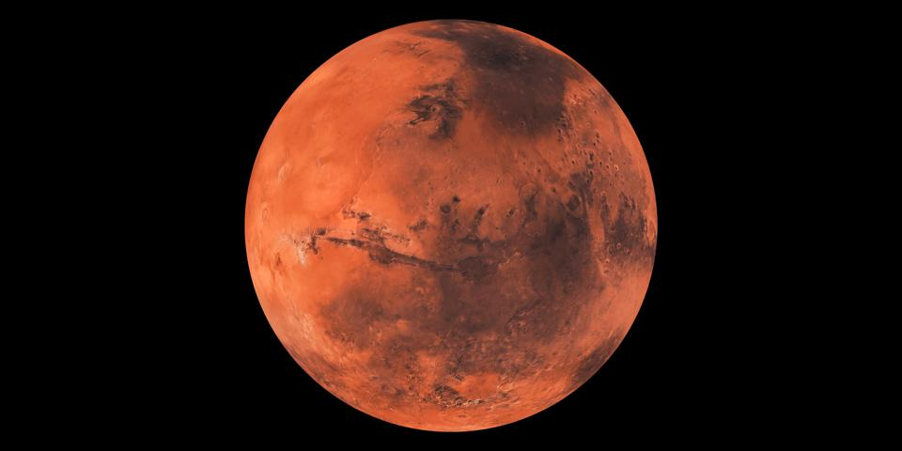
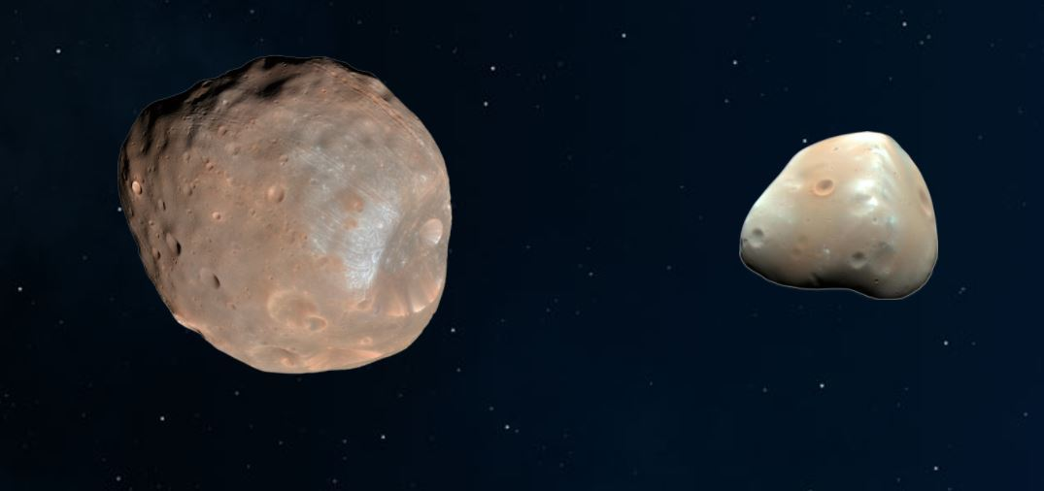
Mars
-red planet
-could be habitable
-lot of films about Mars and Martians
-full of deserts and storms
-cold at night
-has two moons: Phobos and Deimos (small, irregularly shaped objects)
-full of craters like our moon
-almost no atmosphere on Mars, unlike Venus
-ice on both poles

Slide 9
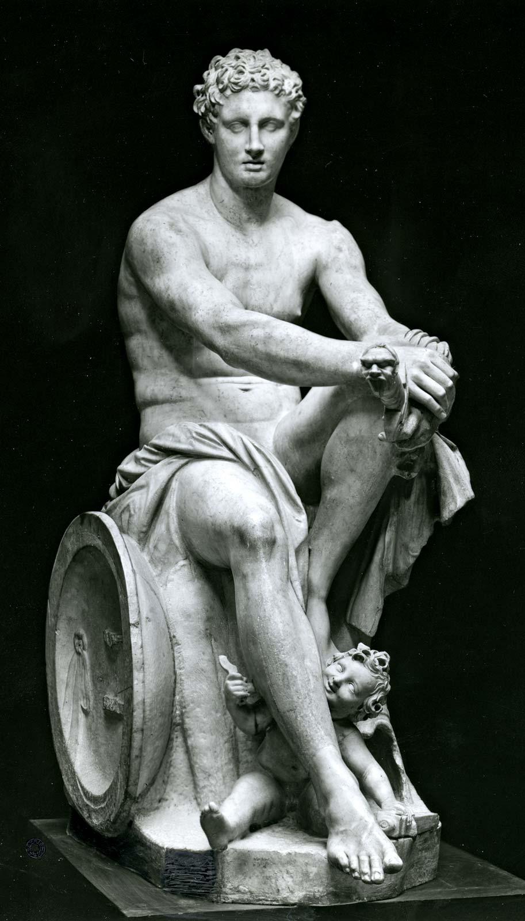
Mars-Ares
God of War, terror and spirit of Battle
Not very popular among Greeks, but the Romans love him
Phobos:
name after son of Mars and Venus, the twin brother
death and panic
phobia
Deimos:
-dread and terror

Slide 10
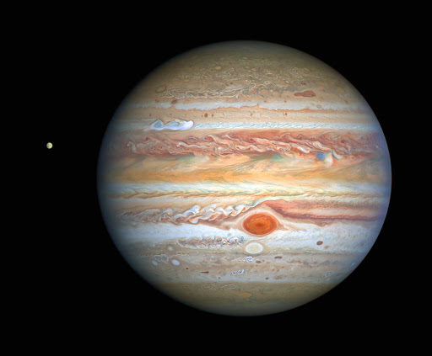
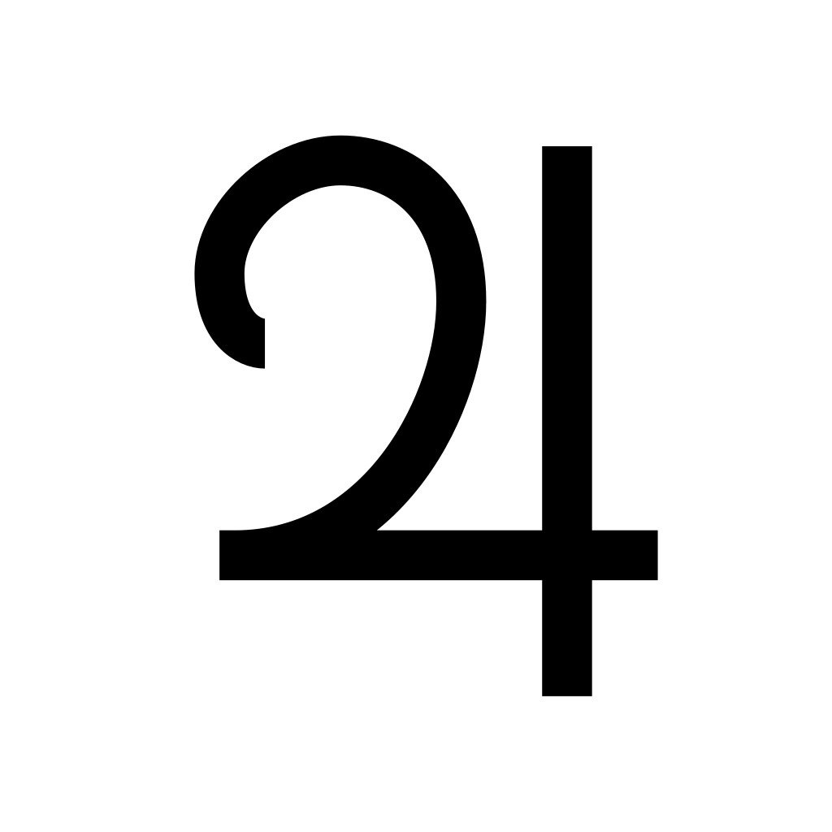
Jupiter
-biggest planet in the solar system
-scientist assume that Jupiter was once going to form as a sun, but then failed.
-gas-giant
-composed of hydrogen and helium
-the red spot: storm in Jupiter’s southern hemisphere with crimson color,1.3 time as wide as our planet. https://www.youtube.com/watch?v=CyRyIFV2RyI
-comet shoemaker levy 9 1994 https://www.youtube.com/watch?v=DgOTcIfU75Y

Slide 11
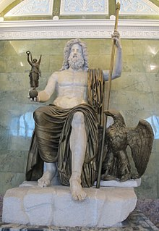
Jupiter-Zeus
The King of all gods
God of sky and thunder

Slide 12
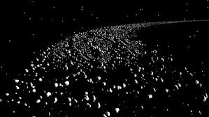
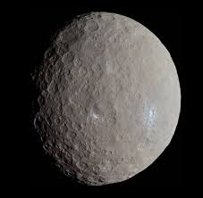
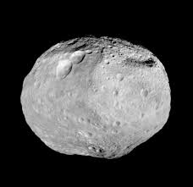
Asteroid belt
Between Mars and Jupiter
Vesta (Hestia, Goddess of Hearth, Family and the Fire), Ceres (Demeter, Goddess of Agriculture)
Dwarf planets (smaller, irregular)
the birth of Jupiter prevented any planetary bodies from forming in the gap between Mars and Jupiter, causing the small objects that were there to collide with each other and fragment into the asteroids seen today. (huge gravitational pull)

Slide 13
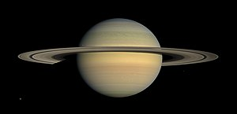
Saturn
Second biggest planet in the solar system
Gas giant
Less dense but more massive
Ring system composed of ice particles, dust, and rock debris
82+ moons (Titan is bigger than Mercury! )

Slide 14
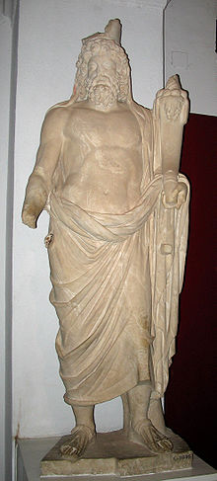
Saturn-Cronus
God of wealth and agriculture
Father of Jupiter, Neptune, Pluto, Juno, etc.
Saturday: Saturn’s day

Slide 15
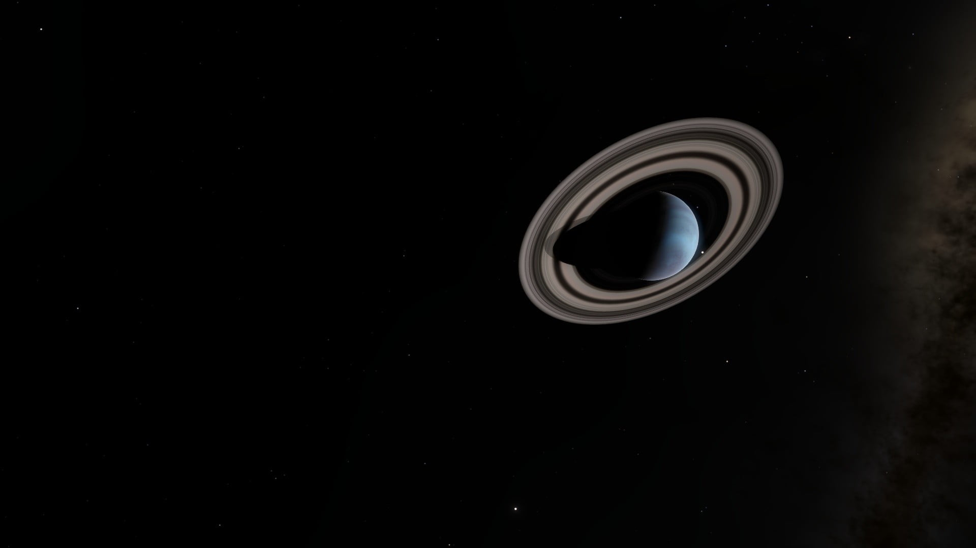
Uranus and Neptune: Ice Giants of the Solar System

Slide 16
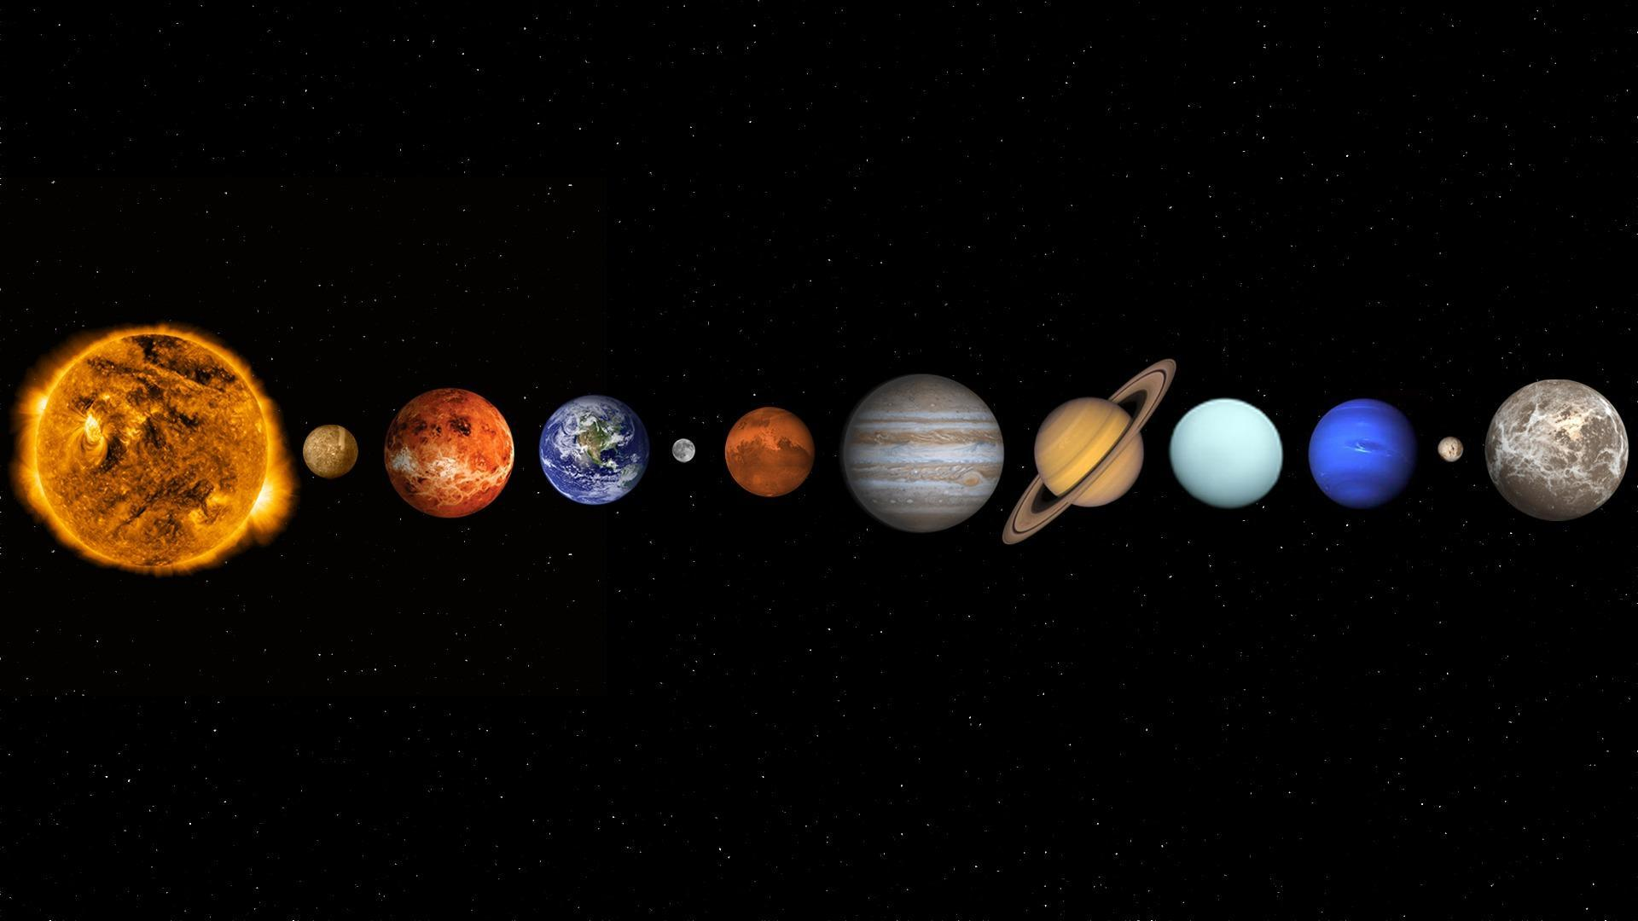
Some Basics
Uranus
Uranus and Neptune are the 7th and 8th planets in order of average distance from the Sun respectively, and are massive gas giants – both of which are over 3 times the diameter of the Earth
In size, they are both immensely larger than Earth – a hollow Neptune can almost contain the volume of 60 Earths and Uranus even more. However, due to their composition, they are much less dense, weighing in at about 15 and 14 Earth masses respectively.
Neptune

Slide 17
Uranus
Facts:
Ice giant
7th planet
Larger than Neptune
Retrograde wind up to 900km/h
HAS RINGS!!!
Greek/Roman mythology > representation of the sky (Ouranos/Caelus)
Has 27 moons

Slide 18
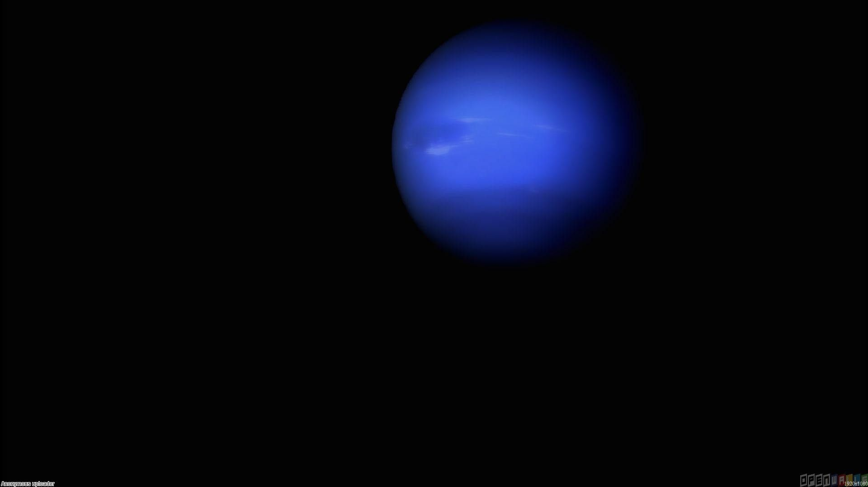
Neptune
Facts:
Ice giant
^{8th} planet
Retrograde wind up to and above 1100km/h (close to and sometimes above the speed of sound on Earth)
ALSO HAS RINGS!!!
Greek/Roman mythology > representation of the sea (Poseidon/Neptune)
Has 14 moons – one is as big as ex-planet Pluto
INTERESTING FACT
Uranus and Neptune swapped orbits a few billion years ago before settling into their current orbits

Slide 19

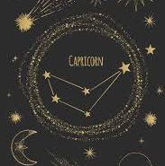
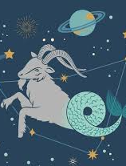
Monthly Zodiac - Capricorn
Dec. 22 – Jan. 20
Tenth zodiac
Zodiac symbol: sea goat
Relates to Sumerian god of wisdom and waters, Enki
Element of Earth
Responsible, disciplined, self-control, good managers
However…
Know-it-all, unforgiving, condescending, expecting the worst

